Slide 1
Price Prediction
DATA MINING
PRAKASH CHOURASIA SHRADA PRADHAN
spradhan6@student.gsu.edu

Slide 2
Outline
Problem Statement
Data description
Data mining algorithms
KNN
ID3
Neural Network
Evaluation
Results
Conclusion

Slide 3
Problem Statement
The main objective of this project is to predict the price of houses on the basis of nine attributes.
From the price, we can also classify whether a person will buy that house or not.

Slide 4
http://lib.stat.cmu.edu/datasets/
1. House price,
2. Income of individuals living in block,
3. House age,
4. Total rooms in block,
5. Total bedrooms in block,
6. Population in block,
7. Number of households in block,
8. Latitude,
9. Longitude.

Slide 5
Sample data
1. 4.5260000000000000e+005
2. 8.3252000000000006e+000
3. 4.1000000000000000e+001
4. 8.8000000000000000e+002
5. 1.2900000000000000e+002
6. 3.2200000000000000e+002
7. 1.2600000000000000e+002
8. 3.7880000000000003e+001
9. -1.2223000000000000e+002

Slide 6
Data mining techniques
KNN algorithm for Price Prediction
ID3 algorithm for Decision Tree
Neural Network

Slide 7
KNN k-Nearest Neighbor imputation
Determine k i.e., the number of nearest neighbors.
Using the distance measure, calculate the distance between the query instance and all the training samples.
The distance of all the training samples are sorted and nearest neighbor based on the k minimum distance is determined.
Since the kNN is supervised learning, get all the categories of the training data for the sorted value which fall under k.
The prediction value is measured by using the majority of nearest neighbors.

Slide 8
Evaluation for KNN
The first quality metric is a measure of how many of the imputed attribute values that were imputed correctly.
In other words, it is a precision metric.
We calculated the mean square error of the incorrectly imputed attribute values

Slide 9
Results
K | Precision Matrics Q | Mean Square Error MSE
3 | 168/600 | 2.30
5 | 186/600 | 1.96
10 | 197/600 | 1.65
20 | 210/600 | 1.52
40 | 232/600 | 1.44

Slide 10
Decision Tree using ID3 algorithm
Is a flowchart like structure in which each internal node represents a “test” on an attribute.
Each branch represents the outcome of the test
Each leaf node represents a class label
The path from root to leaf represents classification rules

Slide 11
ID3 algorithm
Tree is constructed in a top-down recursive divide-and-conquer manner
At start, all the training examples are at the root
Attributes are categorical (if continuous-valued, they are discretized in advance)
Examples are partitioned recursively based on selected attributes
Test attributes are selected on the basis of a heuristic or statistical measure (e.g., information gain)

Slide 12
Attribute Selection
Select the attribute with the highest information gain
Let p_{i} be the probability that an arbitrary tuple in D belongs to class C_{i}, estimated by |C_{i, D}|/|D|
Expected information (entropy) needed to classify a tuple in D:
Information needed (after using A to split D into v partitions) to classify D:
Information gained by branching on attribute A

Slide 13
Simulation Results

Slide 14
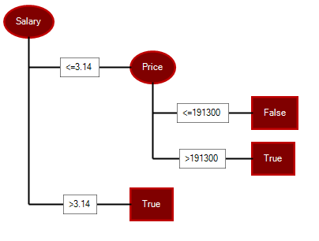
Decision Tree

Slide 15
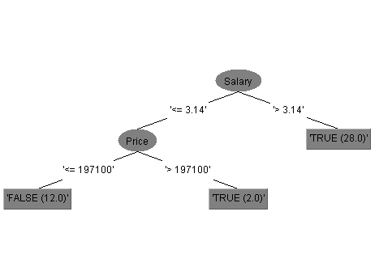
Evaluation for Decision Tree By WEKA

Slide 16
Neural Network
Is systems of interconnected "neurons" which can compute values from inputs, and learn from their adaptive pattern.
An n-dimensional input vector x is mapped into variable y by means of the scalar product and a nonlinear function mapping

Slide 17
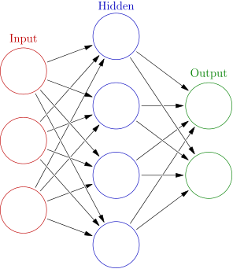
Contd.

Slide 18
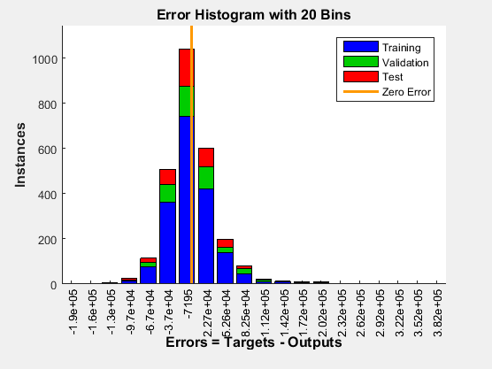
Neural Network Results
Root mean square : 0.0874

Slide 19
Conclusion
Implemented KNN algorithm to predict the price.
Implemented ID3 algorithm for Decision Tree
Used Neural Network to predict the target price.

Slide 20
References

